Slide 1
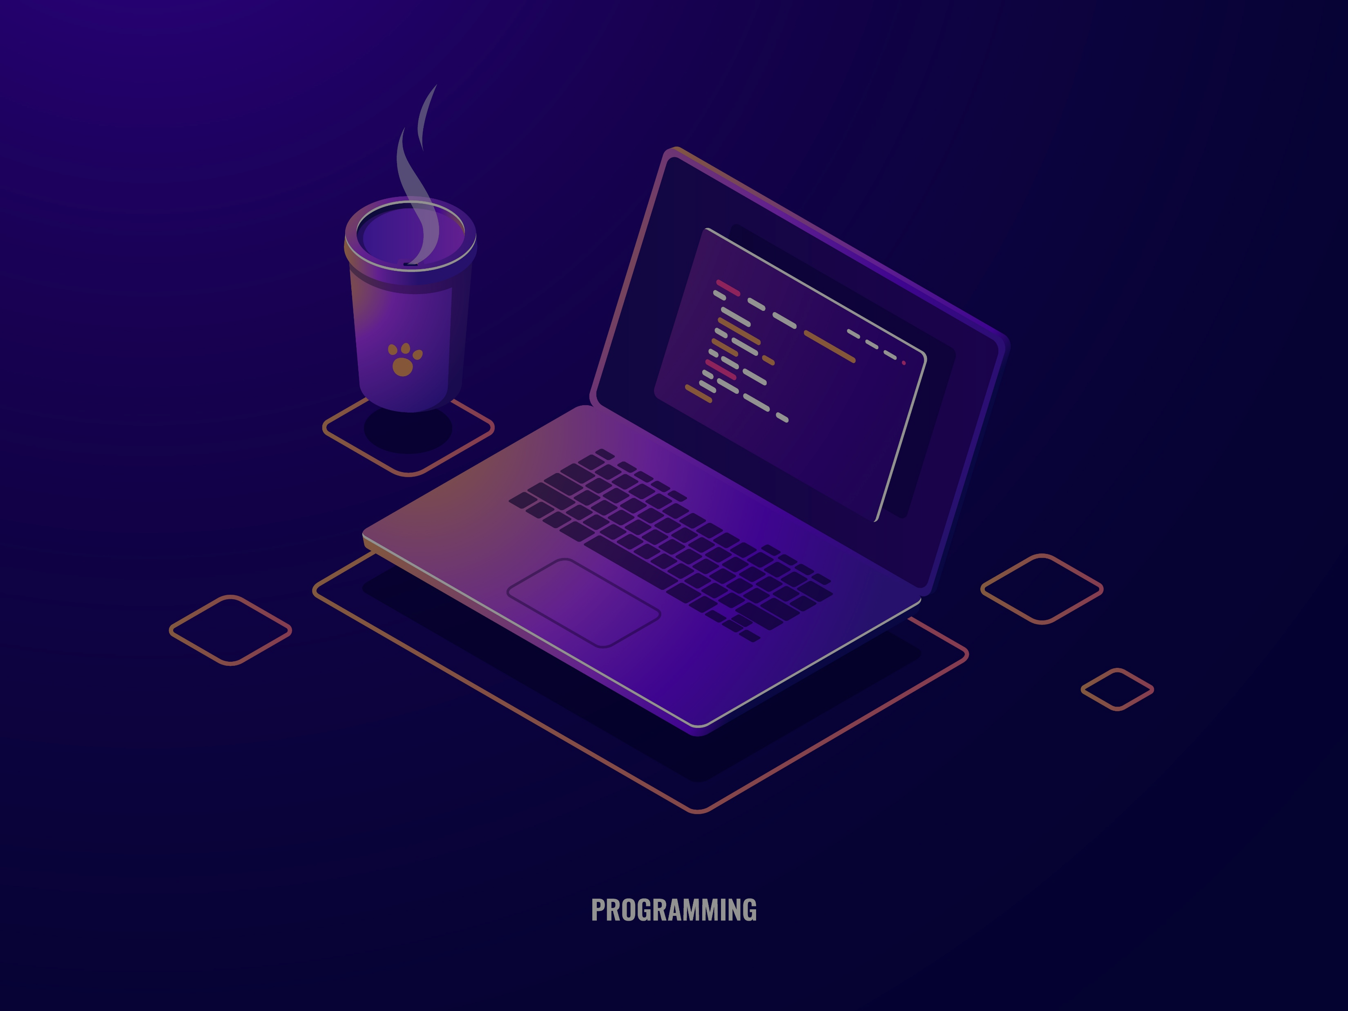
Welcome to Application of
Programming Language-P
Final Project Presentation
Professor SEJAN MOHAMMAD ABRAR SHAKIL
Date: 09 December 2025

Slide 2












📋 Presentation Outline
Duration: 10 Minutes
Welcome & Introduction
Project Structure
1 min
1 min
Team Introduction
Live Demonstration
30 sec
2 min
Project Purpose & Objectives
Code Architecture
1 min
1 min
Technology Stack & Libraries
Limitations & Challenges
1 min
30 sec
Development Schedule
Future Improvements
30 sec
30 sec
Features Overview
Conclusion & Q&A
1.5 min
30 sec

Slide 3




1. Welcome & Introduction
🎯 Student Grade Management System
A Modern Desktop Application for Academic Record Management
Good afternoon, everyone,
Today we are excited to present our final project for the Application of Programming Language course - a comprehensive Student Grade Management System built with Python and Tkinter.
What is this project?
Grade Management
A desktop application designed to help educational institutions efficiently manage student academic records, including: Student information and profiles.
Our system facilitates grade calculation and tracking.
Reporting & Analytics
Data Handling
Provides statistical analysis and reporting capabilities.
Offers robust data import/export capabilities.

Slide 4
2. Team Introduction
👥 Meet the Team
Maruf Shawkat Hossain (25013492)
Hasan Md Mahadi (25013422)
Role: Lead Developer & Database Architect
Role: Developer & Quality Assurance
Profile management system
GUI design and implementation
Responsibilities:
Code architecture and organization
Grading algorithms and calculations
Statistical analysis features
Team Collaboration:
Testing and bug fixing
Documentation
Both members contributed to code reviews, feature planning, and presentation preparation
Used Git for version control and collaborative development
Responsibilities:
Database design and MySQL integration

Slide 5
3. Project Purpose & Objectives
🎯 Project Goals
Primary Purpose: To create a user-friendly, reliable, and efficient system for managing student academic records that demonstrates our proficiency in Python programming and software development.
📚 Learning Objectives
Python Mastery
GUI Development
Object-oriented programming (OOP) principles
Tkinter widgets and layouts
Exception handling and error management
Event-driven programming
File I/O and data persistence
User experience design
Database Integration
Software Engineering
MySQL database design
Modular code architecture
CRUD operations (Create, Read, Update, Delete)
Code reusability and maintainability
Data relationships and foreign keys
Version control with Git
🎓 Academic Impact
Problem Solved:
Solution Provided:
Manual grade calculation is time-consuming and error-prone
Automated grade calculation with validation
Paper-based records are difficult to search and analyze
Digital database with instant search
Lack of instant statistical insights
Real-time statistics and analytics
Professional student profiles with comprehensive information

Slide 6
4. Technology Stack & Libraries
🛠️ Core Technologies
Programming Language
GUI Framework
Database System
Python 3.13
Tkinter (Built-in)
MySQL 8.0
Latest stable version
Cross-platform compatibility
Reliable relational database
Type hints support
Standard library (no installation needed)
ACID compliance
Enhanced error messages
Mature and stable
Excellent performance
Performance improvements
Rich widget collection
Industry-standard SQL
📦 Python Libraries Used
tkinter
Built-in
GUI framework
mysql-connector-python
8.x
MySQL database driver
Pillow (PIL)
Latest
Image processing for profile photos
json
Built-in
JSON data import/export
csv
Built-in
CSV file operations
datetime
Built-in
Date/time handling
os
Built-in
File system operations
typing
Built-in
Type hints and annotations
🔧 Development Tools
IDE: Visual Studio Code
Version Control: Git & GitHub
Database Client: MySQL Workbench
Testing: Manual testing with sample data

Slide 7
5. Development Schedule
📅 Project Timeline (8 Weeks)
Week 1-2: Planning
Oct 14-27
Requirements gathering, database design, project structure
✅ Completed
Week 3-4: Core Development
Oct 28 - Nov 10
Basic GUI, CRUD operations, grade calculations
✅ Completed
Week 5-6: Advanced Features
Nov 11-24
Profile system, statistics, import/export
✅ Completed
Week 7: Testing & Refinement
Nov 25 - Dec 1
Bug fixes, UI improvements, code refactoring
✅ Completed
Week 8: Documentation
Dec 2-8
README, code comments, presentation
🚧 In Progress
📊 Development Milestones
Oct 14: Project Kickoff
Oct 21: Database Schema Finalized
Oct 28: Basic GUI Completed
Nov 4: CRUD Operations Working
Nov 11: Statistics Module Added
Nov 18: Profile System Implemented
Nov 25: Testing & Bug Fixes
Dec 5: Final Presentation Ready

Slide 8





6. Features Overview
✨ Core Features
Student Management
Grade Calculation
Statistical Analysis
➕ Add new students with validation
📝 Five subjects: English, Math, Science, History, ICT
📊 Class average calculation
✏️ Update existing records
🔢 Automatic total calculation (0-500)
🏆 Top performers identification
🗑️ Delete student records
📈 Automatic average calculation (0-100)
📉 Bottom performers identification
🔍 Search by ID or name
🎯 Letter grade assignment (A, B, C, D, F)
📈 Grade distribution (A, B, C, D, F counts)
📊 Sort by multiple criteria
✅ Mark validation (0-100 range)
📚 Subject-wise averages
✓ Pass rate percentage
Student Profiles (Advanced)
Data Management
📷 Profile photo support (200x200 display)
💾 MySQL database persistence
👤 Personal information (21 fields)
📥 Import from JSON
🎓 Academic details
📥 Import from CSV
👨‍👩‍👧 Parent information
📤 Export to CSV
📞 Emergency contacts
🔄 Automatic save on changes
🖼️ Fullscreen view (F11)
✅ Data validation and error handling
📱 Responsive card-based layout

Slide 9
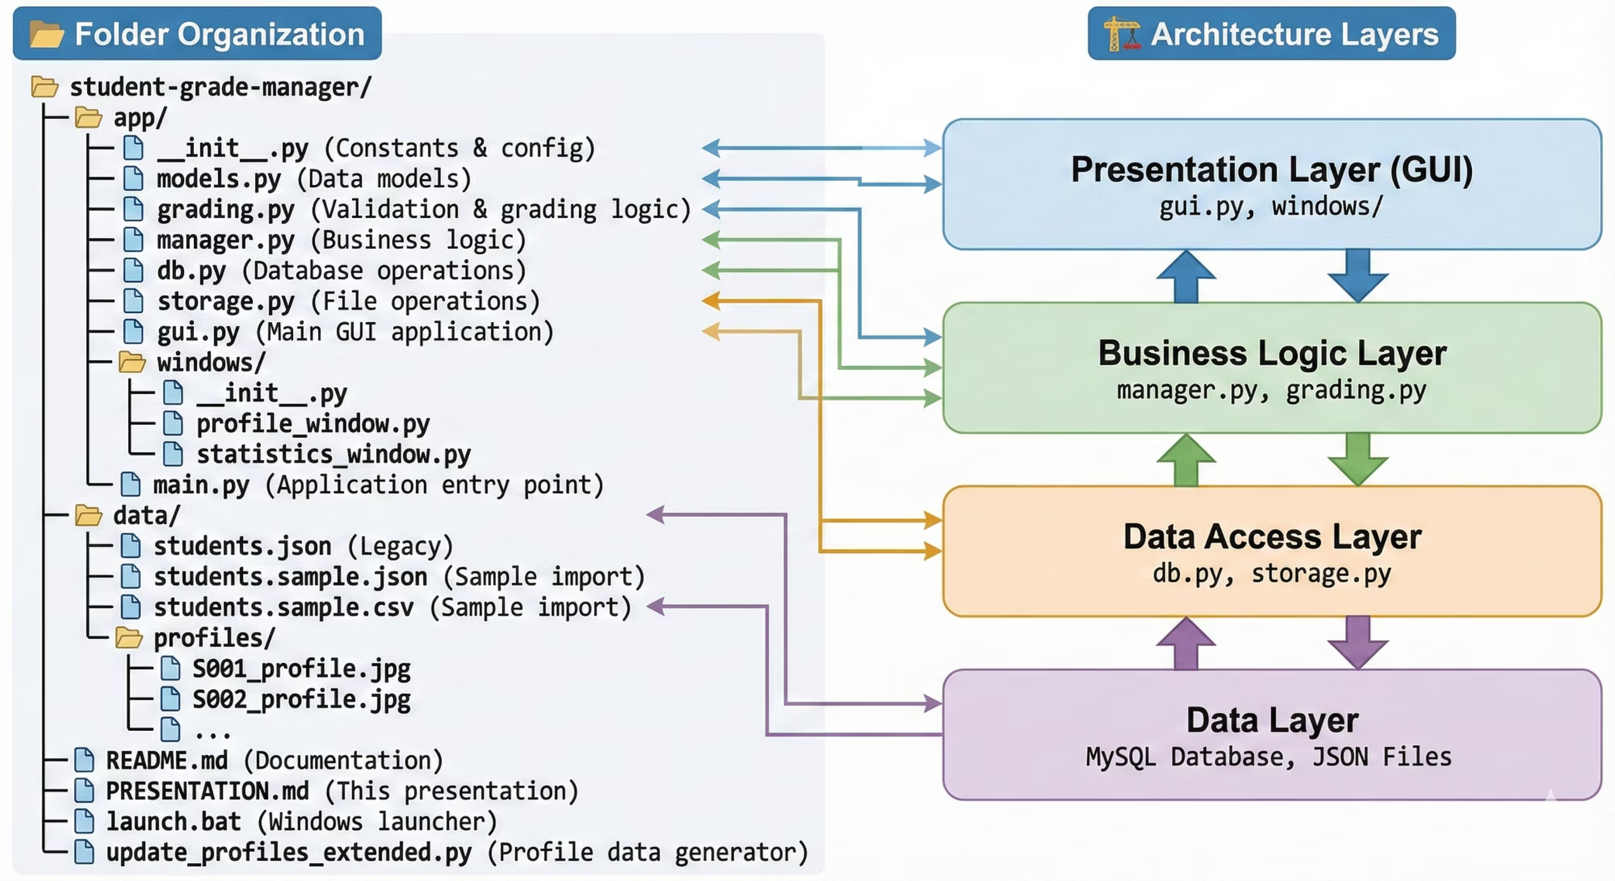
7. Project Structure

Slide 10




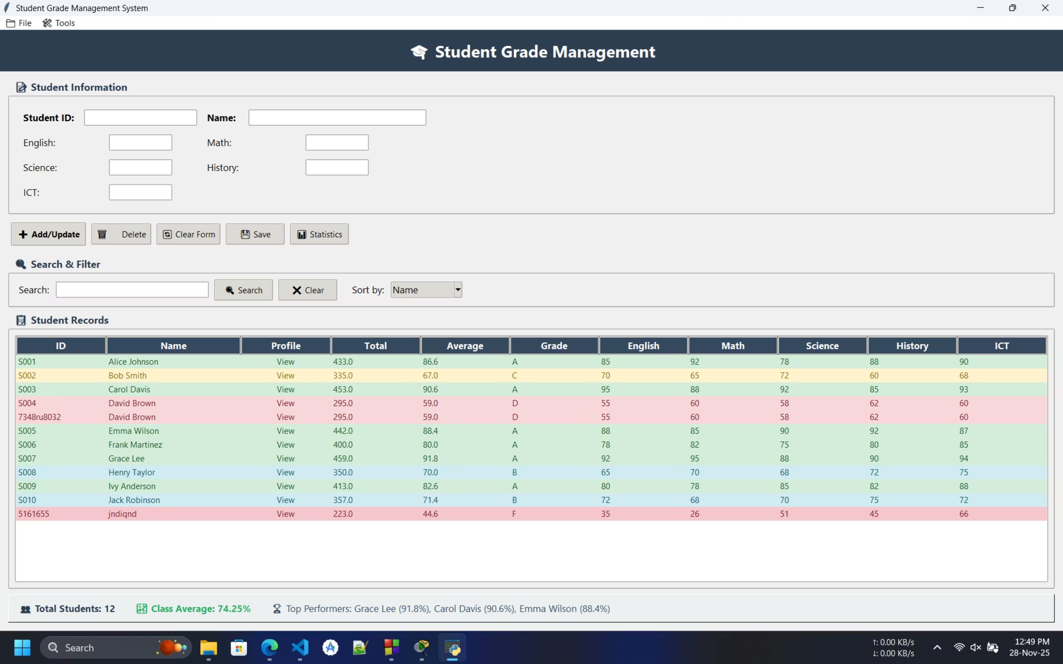





8. Live Demonstration
🖥️ Application Screenshots
Main Window Overview
The main application window provides an intuitive interface for all core grade management tasks:
Student List Table
Input Form
Color-coded rows for quick grade identification.
Located on the left for easy data entry.
Accessible Menu Bar
Live Statistics Panel
At the top for various actions and comprehensive control.
At the bottom for instant insights and real-time monitoring.
Key Elements of the Interface:
Menu Bar
Input Form
Action Buttons
(File, Edit, View, Help) for comprehensive control over the application.
(ID, Name, Subject marks) designed for efficient data input.
(Add, Update, Delete, Search, Clear) for quick and responsive operations.
Student Table
Live Statistics
Features auto-hide scrollbars for clear data visualization without clutter.
(Class Average, Top Student, Total Count) providing real-time data monitoring.

Slide 11
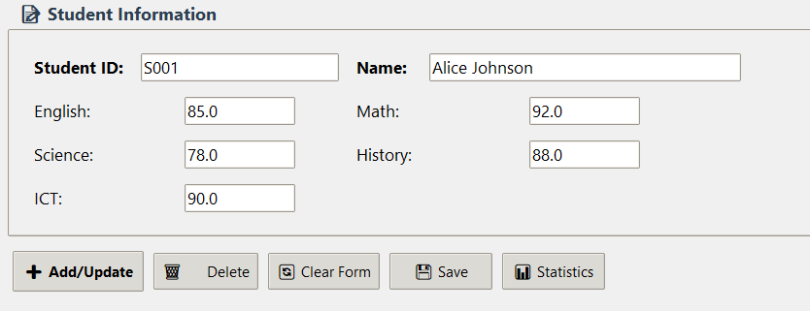





Adding Student Information
This section demonstrates the interactive "Add Student" dialog, showcasing data entry, validation, and automated result calculation upon submission.
Demonstration Workflow:
Enter Student ID
Provide a unique identifier to register each student in the system.
Input Student Name
Record the student's full name for accurate identification.
View Calculated Results
Record Subject Marks
Submit for Processing
The system instantly displays automatically calculated Total, Average, and Grade.
Input marks for each subject, such as English (85), Math (90), and Science (88).
Finalize entries to initiate data processing and secure storage.

Slide 12
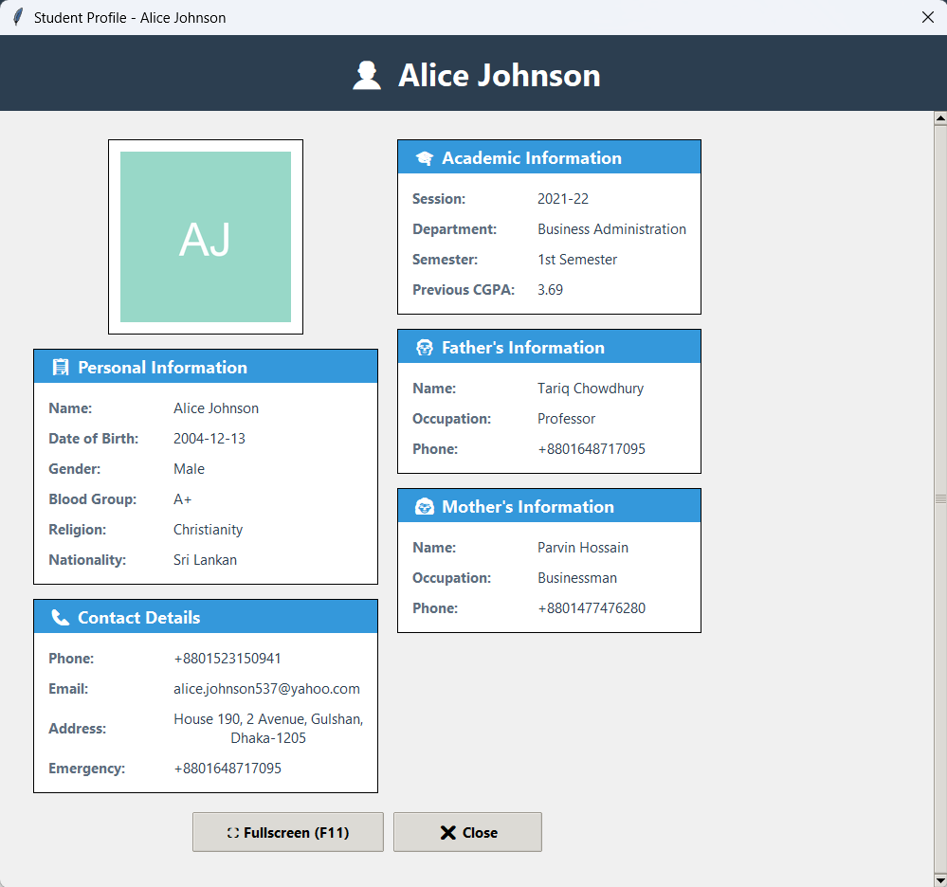



Student Profile Viewer
Dive into comprehensive student data with our intuitive Student Profile Viewer. This window provides an organized, easy-to-navigate interface for all critical student information, ensuring clarity and immediate access to details.
Key Profile Sections:
Personal Information
Full Name, Date of Birth, Gender, Blood Group, Religion, Nationality
Contact Details
Phone Number, Email Address, Residential Address, Emergency Contact
Academic Information
Current Session, Department, Semester, Cumulative GPA (CGPA)

Slide 13
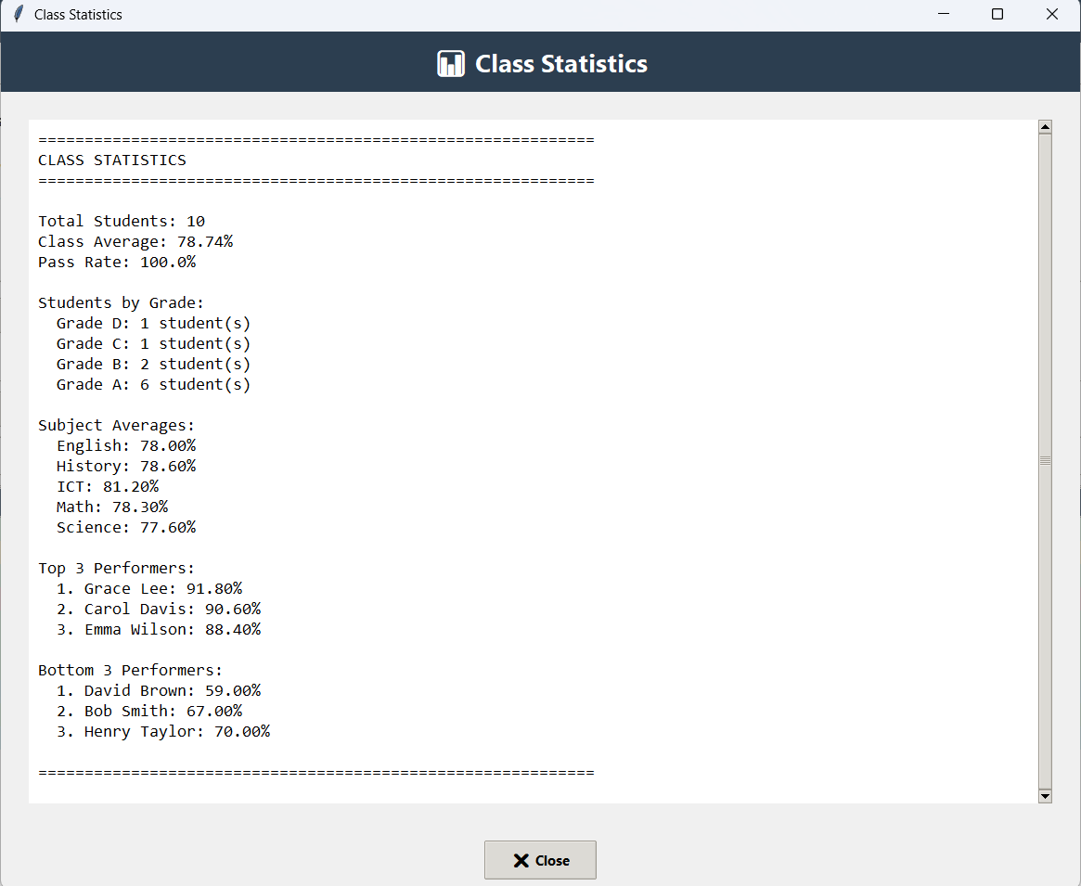
Class Statistics Overview
The Statistics Window provides a concise summary of class performance, including grade distribution and pass rates, vital for quick analysis.
Key Metrics at a Glance:
Total Students: 11
Class Average: 78.5%
Pass Rate: 90.9%
Grade Distribution:
Grade A: 4 students (Outstanding)
Grade B: 3 students (Very Good)
Grade C: 2 students (Good)
Grade D: 1 student (Pass)
Grade F: 1 student (Fail)

Slide 14
Data Management: Import/Export & Search
Efficient data handling is crucial. Our system supports flexible import/export options and robust search capabilities.
Seamless Data Integration
Quick Search Functionality
Search Demo:
Import/Export Workflow:
Enter Term: Type "John" into the search field.
Click Search: Filters results to show only matching students.
File Menu: Access options via File → Import JSON.
Reset: Click "Show All" to clear the search and display all students.
Select File: Choose students.sample.json.
Validation & Load: System performs a validation check, then loads data into the database.
Auto-Refresh: The student table automatically refreshes to display new data.

Slide 15
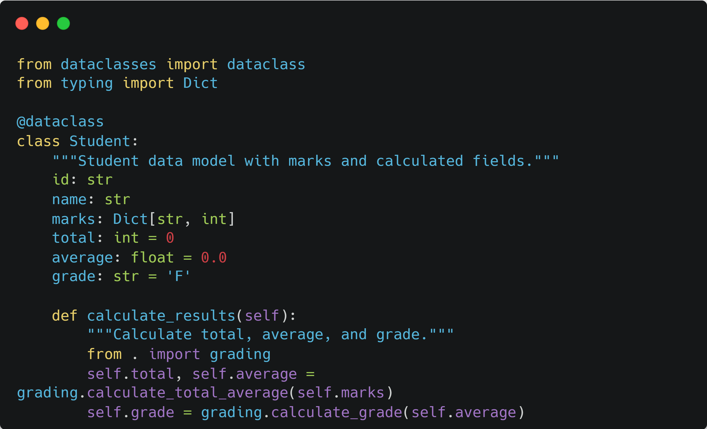
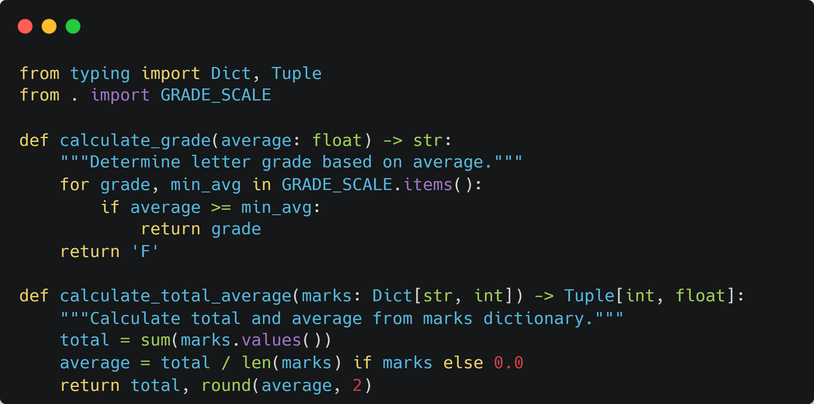
Code Architecture: Student Model & Grade Calculation
Understanding the Core Logic
Our application's robust architecture is built upon well-defined data models and efficient utility functions. Here, we delve into the Student model and the grade calculation logic.
1. Student Model (models.py)
2. Grade Calculation (grading.py)
Key Features:
Type hints for clarity and maintainability.
Design Rationale:
Simple, testable functions for accuracy.
Concise code using @dataclass.
Configurable grade scale for flexibility.
Encapsulates student data and behaviors.
Automates result calculations.

Slide 16
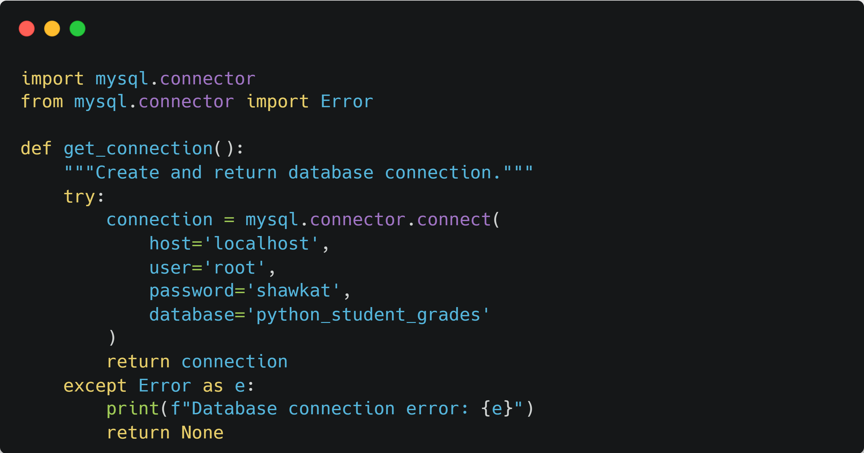
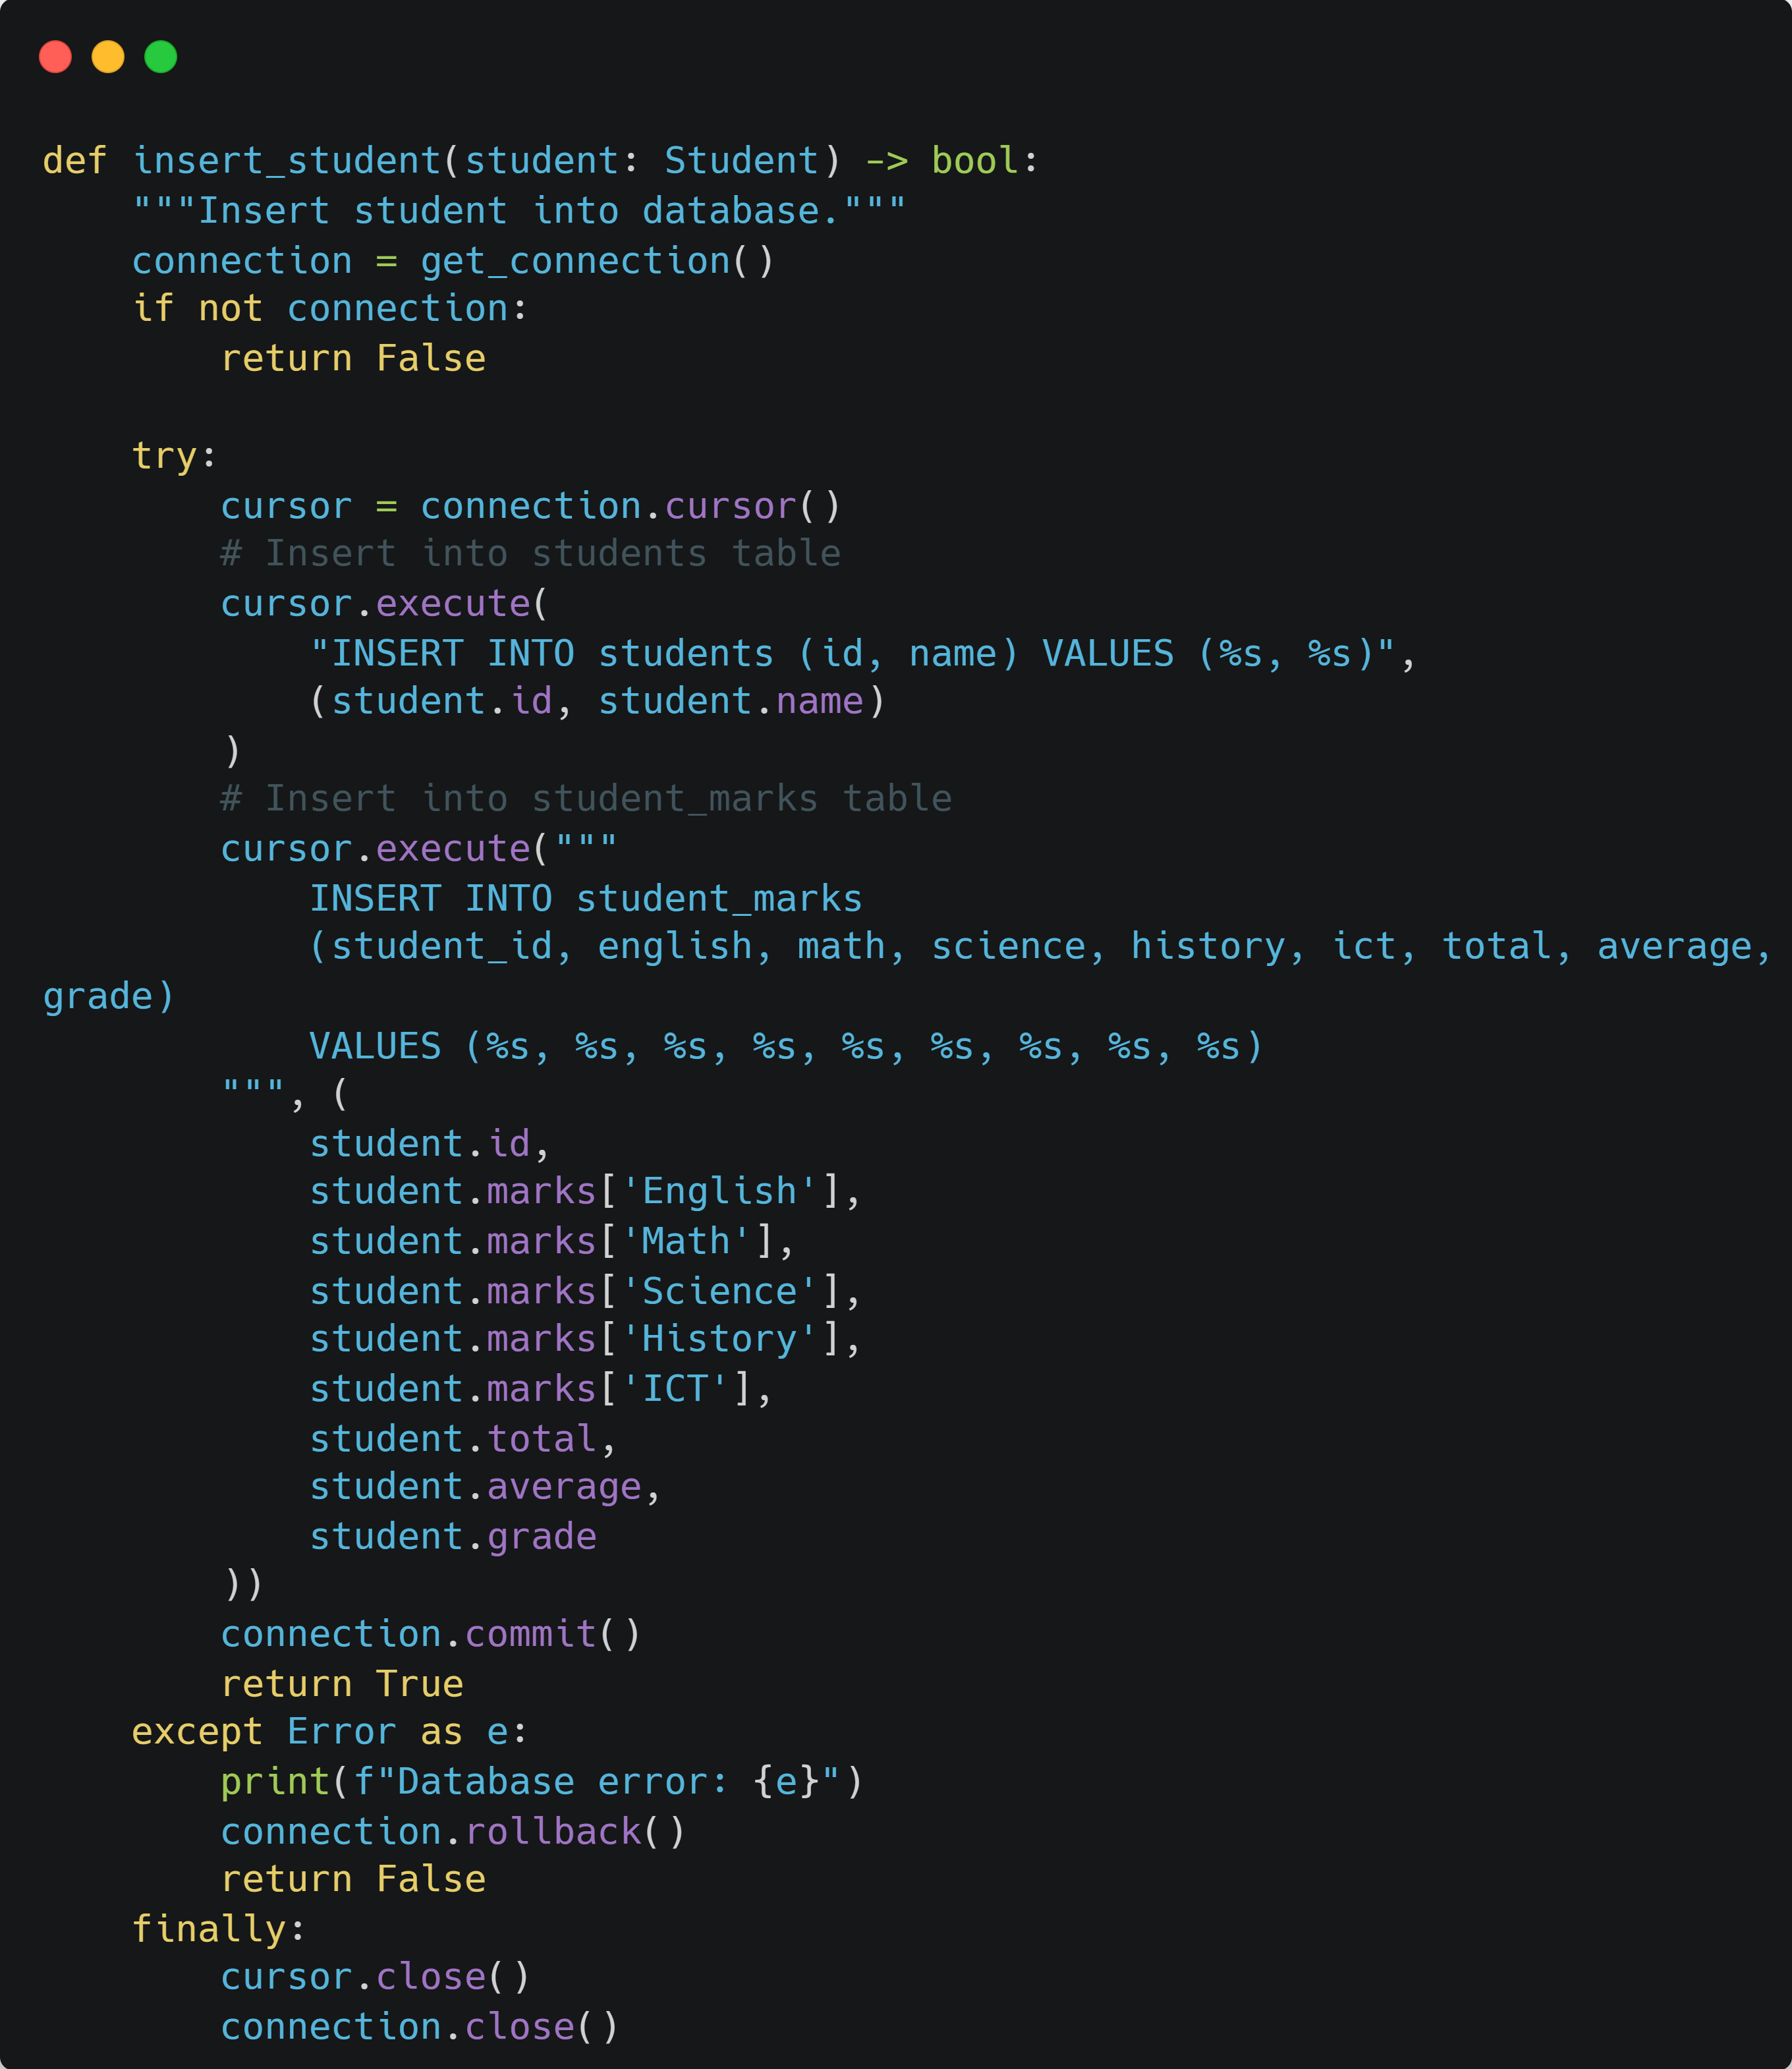
Code Architecture: Database Operations
Ensuring Data Persistence and Integrity
The db.py module handles all interactions with the MySQL database, ensuring reliable storage and retrieval of student data.
Design Principles:
Connection Pooling Concept
Robust Error Handling
Efficiently manages database connections to reduce overhead.
Utilizes try-except blocks for graceful error recovery.
Transaction Management
Resource Cleanup
Ensures data consistency with commit and rollback mechanisms.
Guarantees proper closing of database resources in the finally block.

Slide 17
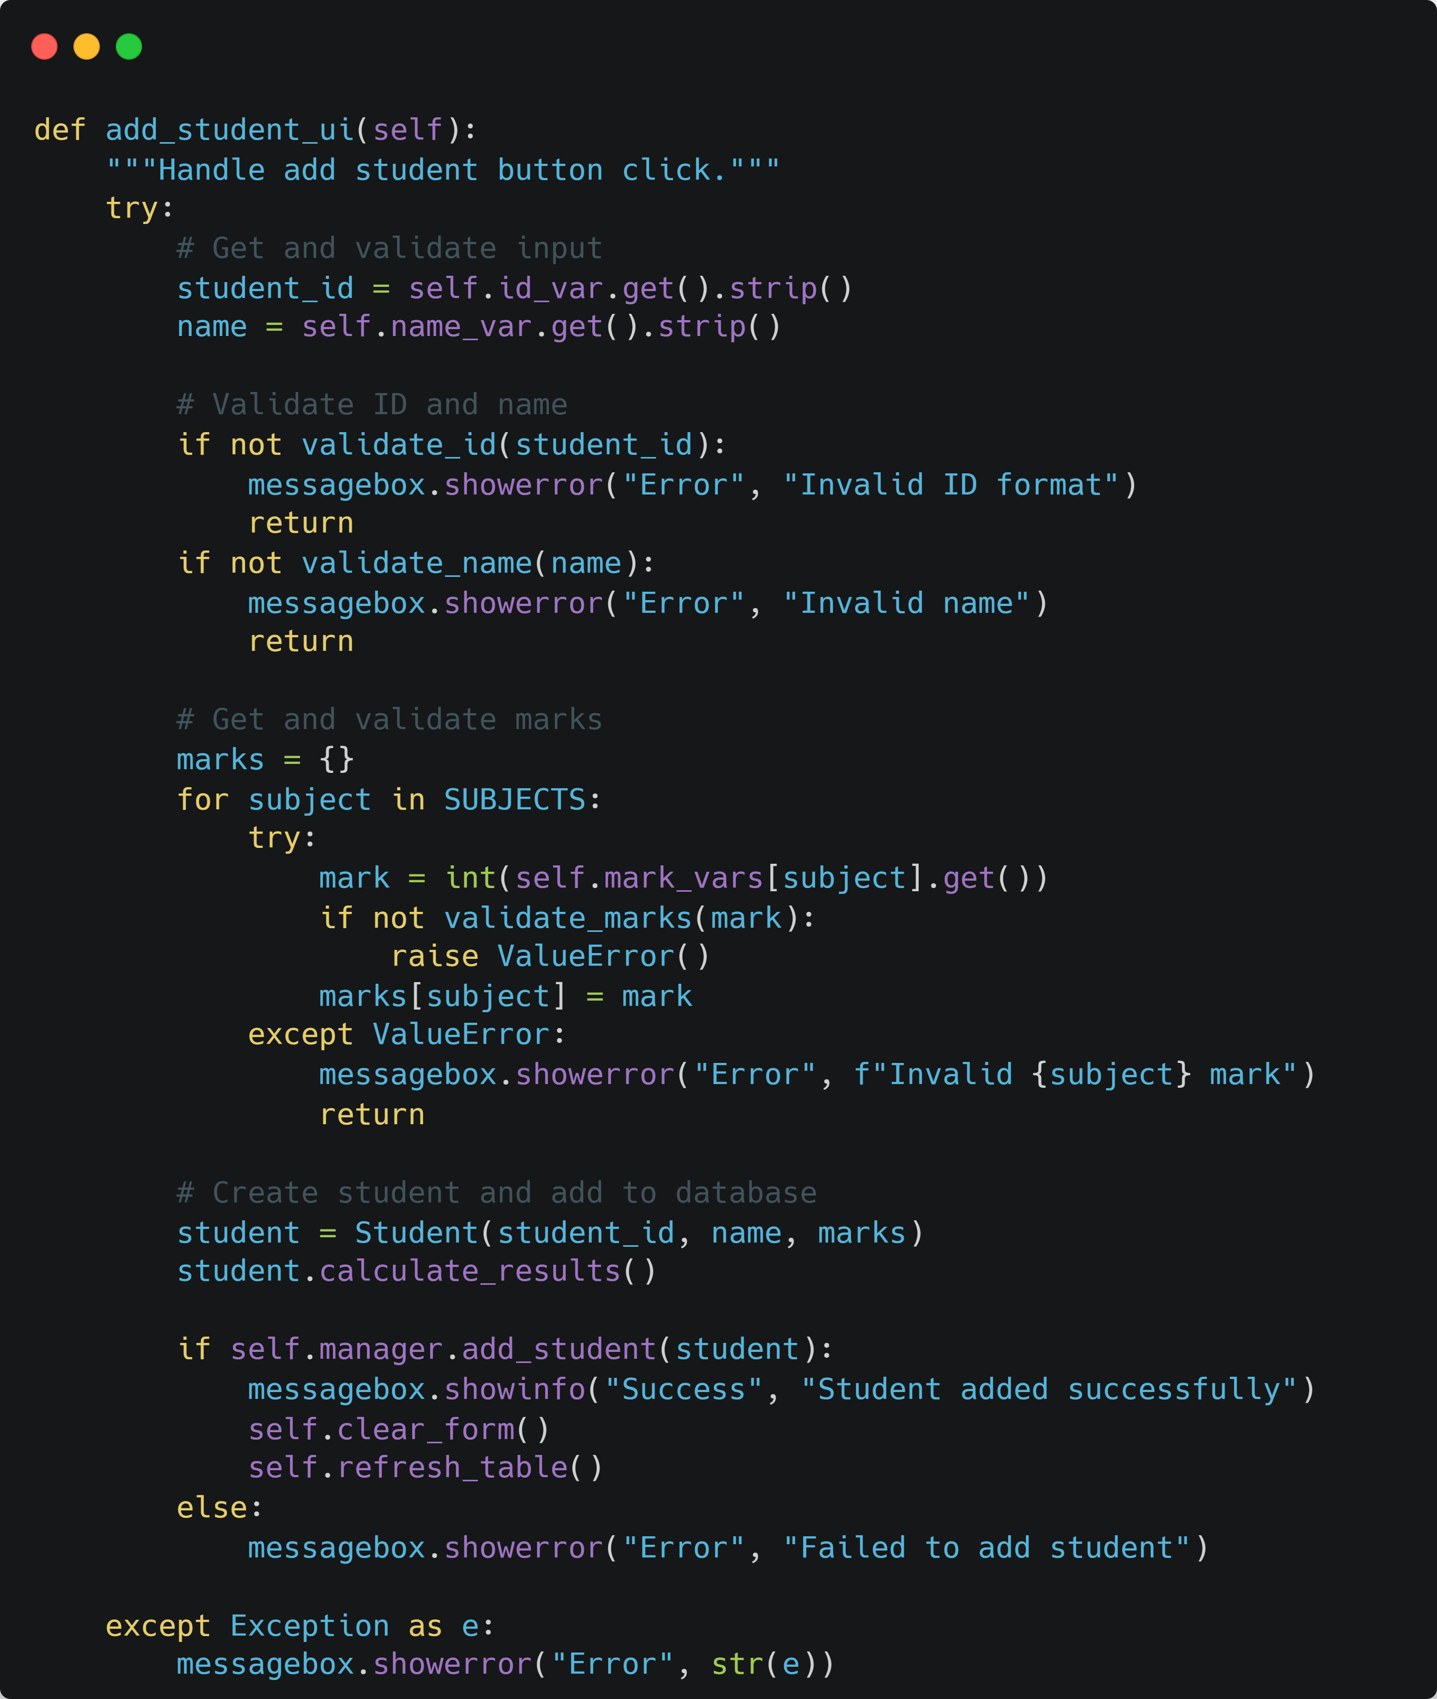
Code Architecture: GUI Event Handling
Responsive and User-Centric Interactions
The gui.py module orchestrates all GUI events, ensuring a smooth and intuitive user experience.
Best Practices in Action:
1
Input Validation
Ensures data integrity by validating user input before processing.
2
Clear Error Messages
Provides user-friendly messages for immediate feedback and guidance.
3
Post-Success Cleanup
Automatically clears the form and refreshes the UI after successful operations.

Slide 18
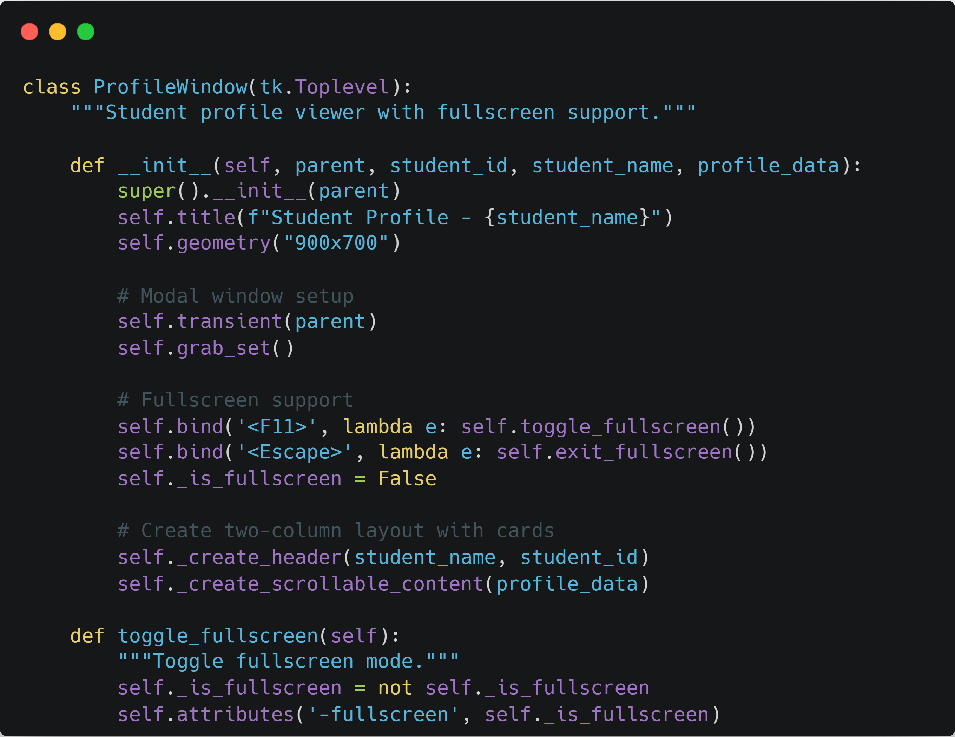
Code Architecture: Profile Window
Dynamic Display with Modern Features
The ProfileWindow class facilitates a rich viewing experience for student profiles, incorporating interactive and responsive elements.
Modern Features Implemented:
Modal Dialog Pattern
Keyboard Shortcuts
Ensures user focus on the profile window until dismissed.
Enhances usability with hotkeys for actions like fullscreen toggle.
Responsive Design
Smooth Scrolling
Adapts the layout and display to various window sizes, including fullscreen.
Provides a fluid experience for navigating through extensive profile data.

Slide 19
Limitations & Future Challenges
Identifying Areas for Growth and Improvement
Our system, while functional, faces clear limitations that are now becoming exciting opportunities for innovation and growth.
Single User System
Local Database Only
Limited Search
Currently supports a single user, lacking multi-user capabilities, authentication, and role-based access for broader operations.
Relies solely on a local MySQL database, hindering remote access and collaborative efforts for distributed teams.
Offers basic search by ID or name; advanced filtering and fuzzy search are absent, making specific data retrieval challenging.
No Data Backup
Local Photo Storage
Lacks automated or cloud backup solutions, presenting a significant risk of data loss.
Photos are stored locally without cloud integration, restricting remote accessibility and sharing.

Slide 20



📊 Project Overview
What We Built
What We Learned
What We Achieved
Modern desktop application: Over 2,000 lines of Python code
Python Mastery: Object-Oriented Programming (OOP) and GUI development
Fully Functional System: A complete grade management solution
Robust MySQL database: Featuring 3 normalized tables
Code Excellence: Professional-quality code organization and structure
Database Expertise: SQL and efficient database design principles
Comprehensive student profiles: Detailed 21-field records
Thorough Documentation: Comprehensive and user-friendly documentation
Architectural Insight: Software architecture and design patterns
Powerful analytics: Statistical analysis and reporting features
Development Workflow: Git version control for collaborative projects
Practical Application: A real-world applicable project demonstrating key skills
Seamless data handling: Advanced import/export capabilities
Team Synergy: Effective team collaboration strategies

Slide 21





🎯 Future Enhancements & Vision
🌟 Future Plans
🌟 Long-Term Vision: Complete School Management System
01
Student Info System
PDF Report Generation
02
Fee Management
Automated Data Backup
Timetable Scheduling
03
Library Management
Advanced Search Filters
Transportation Management
04
Comprehensive User Manual
Event Management
05
Robust Unit Tests

Slide 22

🎉 Thank You for Your Time!
We sincerely appreciate your attention and engagement during our presentation.
We are now open to any questions you may have about our project.
Explore Our Code
You are welcome to view the source code for our project.

